Slide 1
HR Analytics Case Study

Slide 2
Background – HR Analytics Case Study
A large company named XYZ, employs, at any given point of time, around 4000 employees. However, every year, around 15% of its employees leave the company. Since the attrition level is too high, the management wants to use predictive modelling to bring it down.
Hence, the objectives of the analysis are to:
Help company XYZ identify current employees that are very likely to leave
Recommend ways for company XYZ to decrease its attrition level in the future
The analysis is divided into three parts:
Data Understanding – Source of data, patterns in the data
Predictive modelling of attrition
Recommending ways for company XYZ to decrease its level of attrition

Slide 3
Data Understanding – 4 broad sources of data
The data received for the analysis can be divided into 4 broad categories -
General Data – General data, acquired from HR
Employee Survey Data – Data collected from yearly employee survey
Manager Survey Data – Data collected from yearly manager survey
Biometric Data – Daily in and out times for each employee, collected using biometric attendance machines
General Data
Age
Attrition (Yes/No)
Department
Education Field
Manager Survey Data
Job Involvement
Performance Rating
Employee Survey Data
Environment Satisfaction
Job Satisfaction
Work Life Balance
Biometric Data
In Time
Out Time

Slide 4
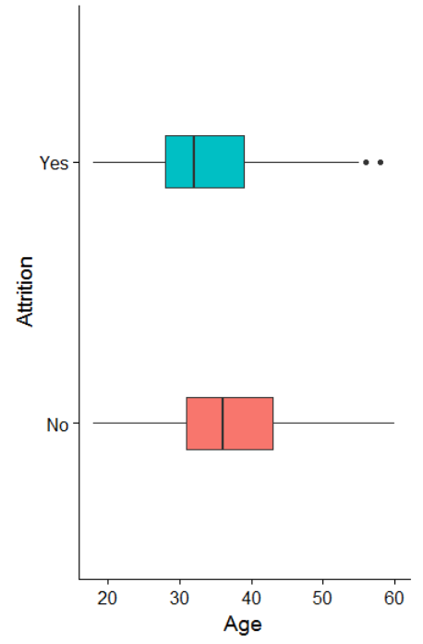
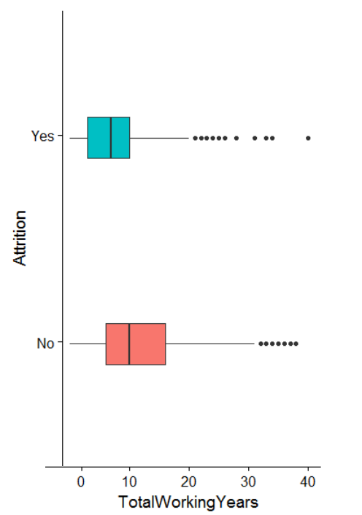
Recommendations – Factors that make employees stay/leave?
Age
Employees aged 36 years and above are more likely to stay*
Employees aged 32 years and below are more likely to leave*
Experience
Employees that have worked for a total of 10 years or more are more likely to stay*
Employees that have worked for a total of 7 years or less are more likely to leave*
*Coefficients of the variables Age and TotalWorkingYears are significant. Among attritions, median age = 32 and median exp. = 7. Among non-attritions, median age = 36 and median exp. = 10

Slide 5
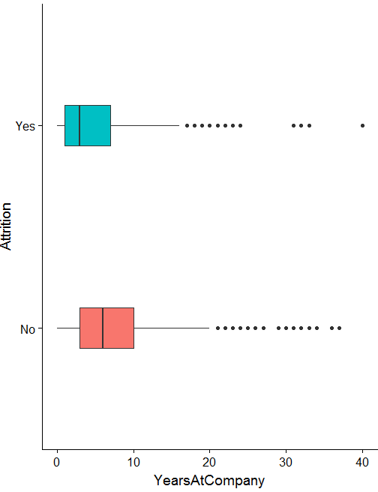
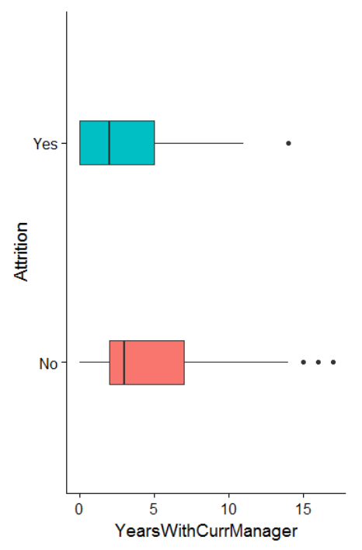
Recommendations – Factors that make employees stay/leave?
YearsAtCompany
Employees those have spent >5 years are more likely to stay*
Employees those are <5 years in this company are more likely to leave*
Years with Current Manager
Employees that have spent 3 years or more under the same manager are more likely to stay*
Employees that have spent 2 years or less under the same manager are more likely to leave*
*Coefficients of the variables TrainingTimesLastYear and YearsWithCurrManager are significant. Rest of the data is based on means/medians etc.

Slide 6
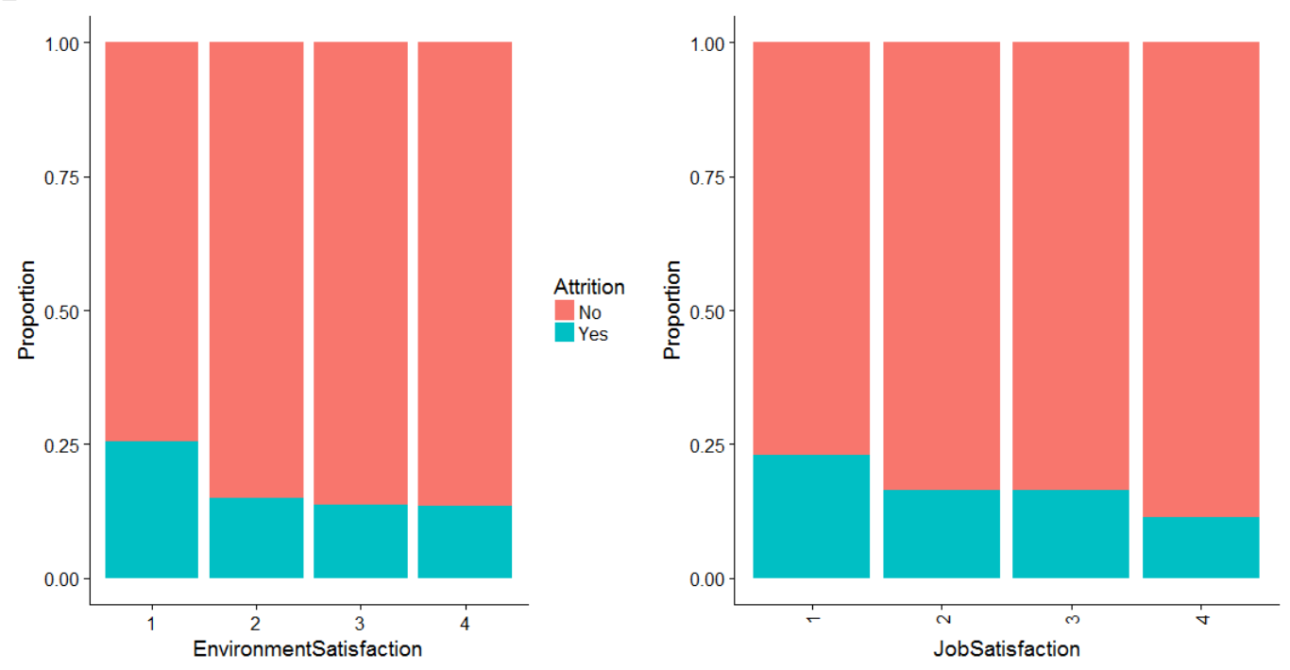
Recommendations – Factors that make employees stay/leave?
Job Satisfaction
Employees that have medium, high or very high levels of job satisfaction, are more likely to stay*
Employees that have low levels of job satisfaction, are more likely to leave*
Environment Satisfaction
Employees that have medium, high or very high levels of environment satisfaction, are more likely to stay*
Employees that have low levels of environment satisfaction, are more likely to leave*
*Coefficients of the variables JobSatisfaction and EnvironmentSatisfaction are significant. Employees were asked to report their job satisfaction and work environment satisfaction levels in a survey.

Slide 7
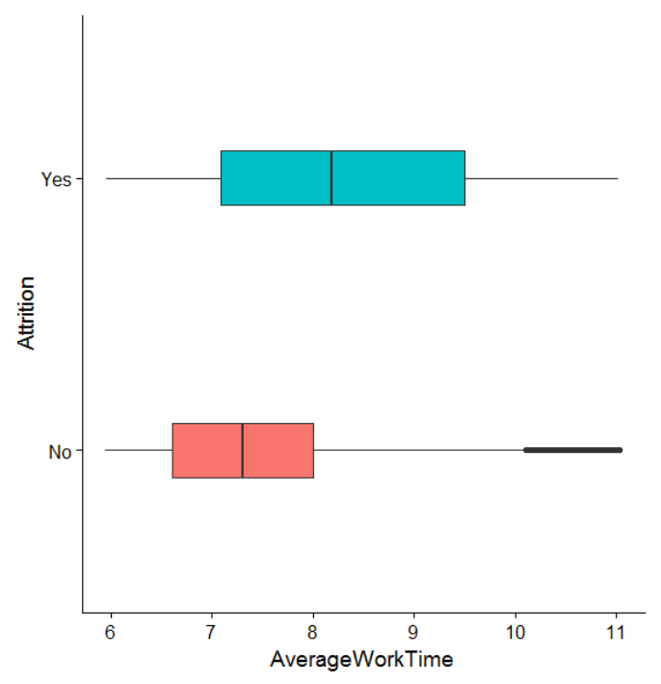
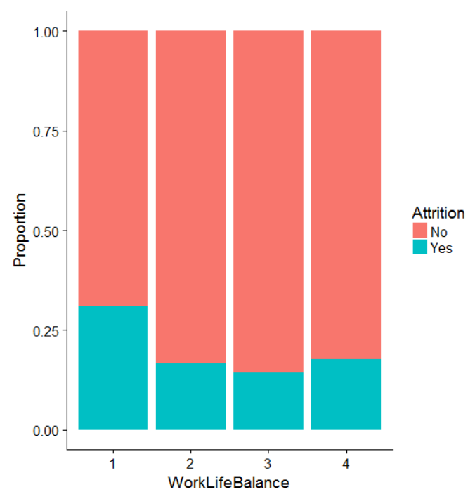
Recommendations – Factors that make employees stay/leave?
Average Work Hours
Employees that, on average work for 7.3 hours or less, are more likely to stay*
Employees that, on average work for 8.2 hours or more, are more likely to leave*
Work Life Balance
Employees that rated their work life balance as good, better or best, are more likely to stay**
Employees that rated their work life balance as bad, are more likely to leave**
*Coefficients of the variables AverageWorkTime and WorkLIfeBalance are significant. Average work hours data is based on means/medians etc. Employees were asked to report their level of work life balance in a survey.

Slide 8
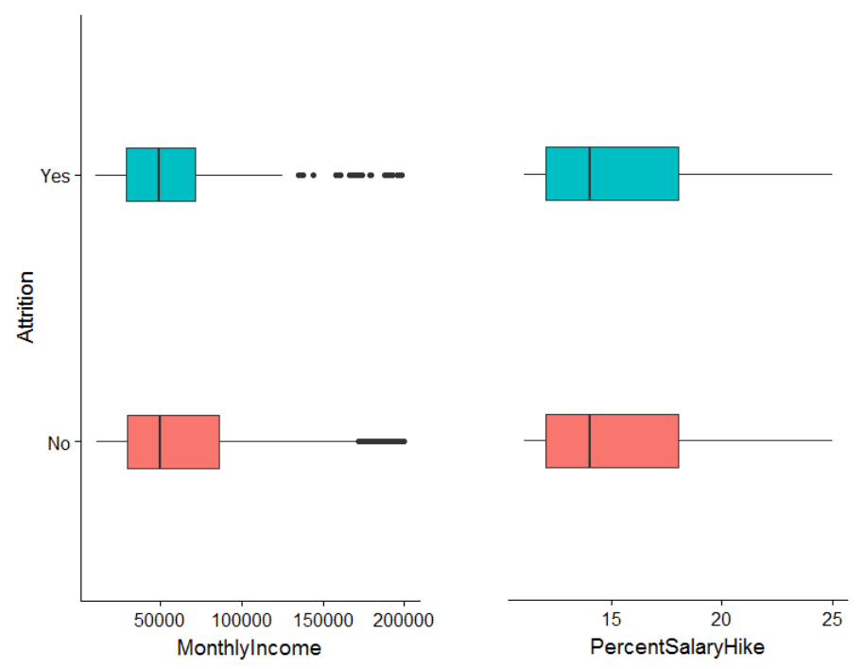
Recommendations – Factors that surprisingly don’t affect attrition
Monthly Income and Percent Salary Hike do not affect attrition*
*Coefficients of these variables are not significant

Slide 9
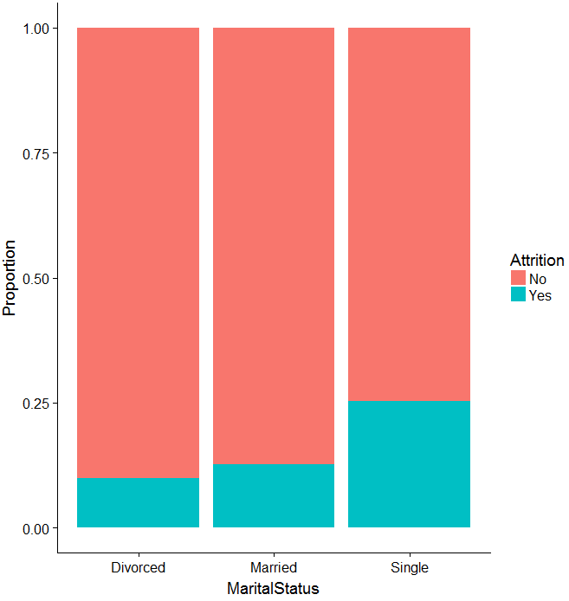
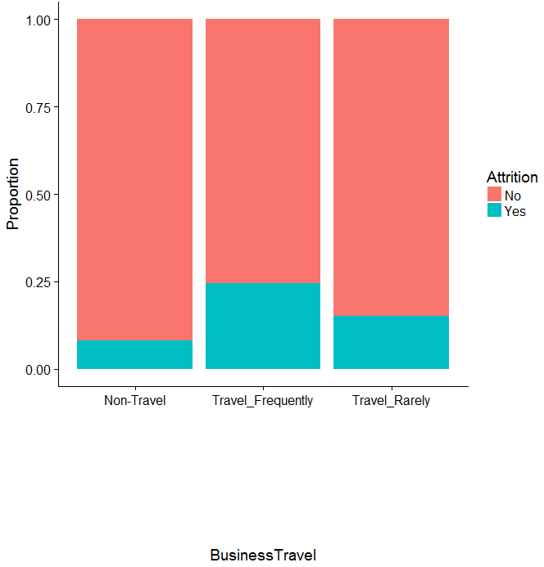
Recommendations – Factors that affects attrition
Employees taking frequent Business travels are likely to leave*
Singles/Bachelors are likely to leave*
*Coefficients of these variables are not significant

Slide 10
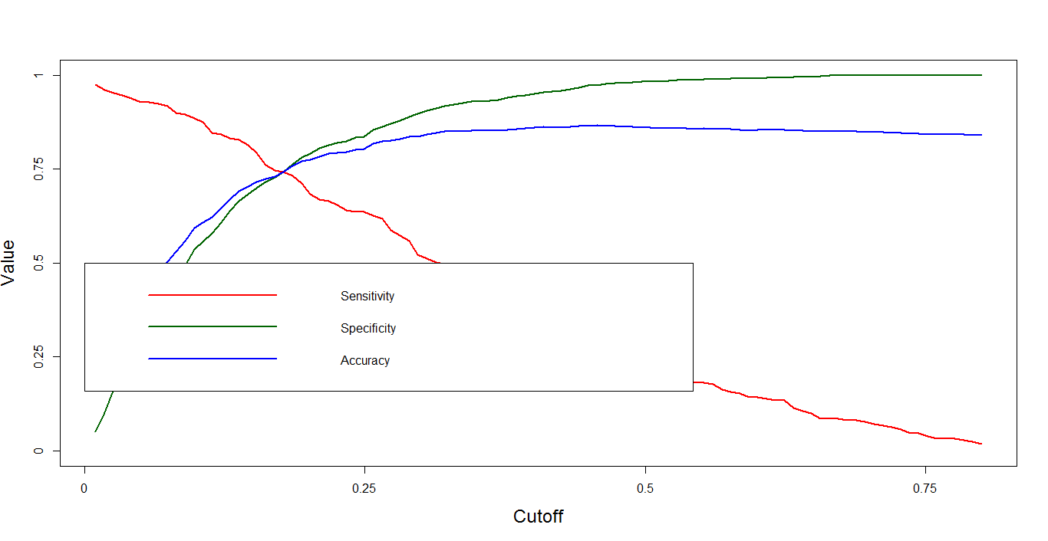
Model testing plots
 |  | test_cutoff_turnover
test_actual_turnover |  | NO | YES
 | NO | 803 | 278
 | YES | 54 | 155

Slide 11
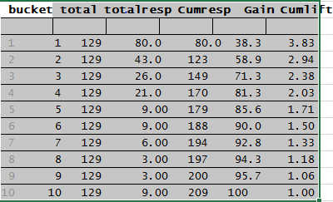
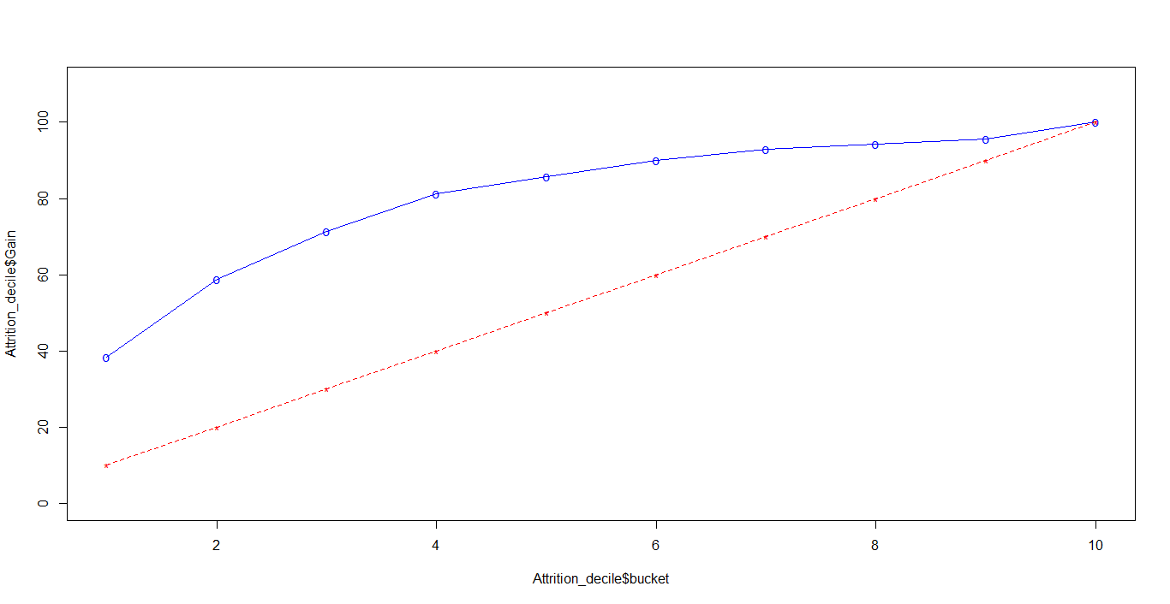
Lift and Gain Chart
By addressing top 40 % of employees predicted by this model, we can target 81% turnover candidates.

Slide 12
Recommendations
Current employees:
  Work life balance should be improved
  Work environment should be improved. HR s can arrange for fun events involving family visits. Organise games, competitions, trips.
  The manager of an employee should not be changed very often
  Employees should be provided relevant training regularly, especially for its younger/singles employees and should be engaged in R&D works for their relevant departments and must be awarded.
  Work load should be reduced by properly managing the work among the employees. Few employees seems to stretch their work hours over the entire year.
  Give timely promotion or introduce Bonus.
Future employees (changes in hiring process):
  The company should follow either one of the strategies given below –
    Hire older people with decent work experience.
    Avoid Hiring candidates who seem to switch too frequently.
  It could also opt for a combination of the two

